Slide 1
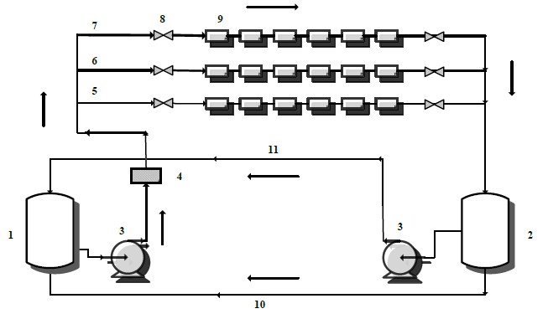
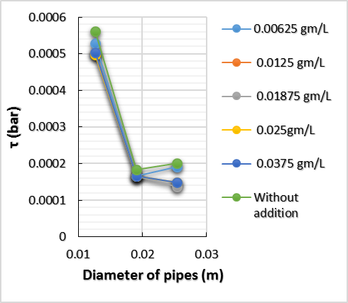
The 3rd International Conference of Engineering Sciences (CESC 2025)
Paper title ………………………………………………………..
First Author^{1*} ; Second Author²
¹Affiliation
²Affiliation
Email: (test@uomustansiriyah.edu.iq)
Abstract
Over the last decade, Nanotechnology has been developed and enter in many fields especially in the oil and gas industries such as gas mobility control, sensing or imaging, enhanced oil recovery and other applications. Nanotechnology research and development in the oil and gas industries are very active and this is because of special properties of nanoparticles. The purpose of this paper is to review recent research into the effect of nanoparticles of titanium oxide (TiO2) on reduce crude oil viscosity that produce from atmospheric distillation. RCR has high viscosity and transport of it is very difficult through pipes caused many problems and financial loses so that many treatments are needed to overcome these problems. This research investigated many parameters through three pipes with different diameters (0.0127, 0.01905 and 0.0254 m) I.D., different concentrations (0.00625, 0.0125, 0.01875, 0.025 and 0.0375 (gm/L) w/v) at 50 oC and flow rate is about 50% of maximum. The results of this research: are display below:-
The drag reduction performance is much better in larger pipes diameter than smaller, TiO2 NP's effect on RCR viscosity and the maximum percentage of viscosity deviation is about 1.6% and addition of TiO2 NP's to RCR is reduced pressure drop, %Dr and shear stress.
Introduction
The product .
Materials and Methods
Material used
1. test
Table 1. Physical Properties f TiO2 Nano-Powder
2. Reduce crude oil
RCR that be used in experiment is taken from Al-Samawah refinery,
The physical properties are shown in table (2).
Experiments Procedure
Firstly fill the open tank with RCR and run the system. Then Pumping RCR through first, second and third pipe respectively and scored initial readings of pressure after that adding the amount of TiO2 nanoparticles to open tank and recycle it for 30 minutes to make sure that mixture is mixing very well. Later, repeat previous steps to recognize the improvement. Lastly receiving tank and second pump are used to recycle RCR to the first tank for continuation process.
Chemical Formula | TiO₂
Appearance (Color) | white
Molecular Weight | 79.866 g/mol
Average particle size | 10-30 nm
Appearance (Form) | Powder
Surface area (m2/g) | >50 m2/gm
Figure 5. Effect of Re on %Dr at different concentration at 0.01905 m I.D. and 50 ºC.
Figure 6. Effect of Re on %Dr at different concentration at 0.0254 m I.D. and 50 ºC.
2. Effect of concentration
Figures (7 and 8) evidence that viscosity and pressure drop are decreased with increased concentration of TiO2 nanoparticles and this is due to breakage C-S bonds in asphaltene which is unstable and this occurs because of exothermic chemical reactions between metal particles and oil phase
The Viscosity @ 50 ºC (c.st) | Sp.gr. | API
252 | 0.93 | 20.65
Figure 7. Effect of conc. on viscosity at different pipes and 50 ºC.
Figure 8. Effect of conc. on pressure drop at different s pipes and 50 ºC.
3. Friction factor
Figures from (9 to 11) display the effect of Re on friction factor.it can be seen that the friction factor was calculated through two equations. The f which is calculated by equation (2) was smaller than f in eq.(1).
$f=(64/Rⅇ)$ Poisuell's equation (4)
$f=(Δp⋅d∕4L)/(ρ⋅u 2⁄2)$ Fanning equation (5)
1)Open tank. 2) Receiving tank. 3) Pump 4) Flow meter 5, 6, 7) Pipe of 0.5, 0.75 and 1 inch 8) Valve 9) Pressure gauge 10) By-pass pipe 11) By-pass pipe connect with pump.
Figure 1. Schematic diagram the flow of system.
Figure 9. Effect of Re on friction factor at 0.0127 m I.D. and 50 ºC.
Figure 10. Effect of Re on friction factor at 0.0127 m I.D. and 50 ºC.
Figure 11. Effect of Re on friction factor at 0.0254 m I.D. and 50 ºC.
Results & Discussion
test.
test.
Conclusions
ACKNOWLEDGEMENTS
test.
Figure 2. Effect of pipe diameter on Re at different concentration at 50 ºC.
Figure 3. Effect of pipe diameter on shear stress at different concentration and 50 ºC.
Figure 4. Effect of Re on %Dr at different concentration at 0.0127 m I.D. and 50 ºC.

